Slide 1
A New Approach to Modeling Primary Healthcare Workforce Needs:
Using Data to Improve Planning and Allocation of State Resources to Respond to Population Health Needs in Utah
Michael K. Magill, MD
Director, Utah Area Health Education Centers Program
Professor and Chair Emeritus, Department of Family and Preventive Medicine
University of Utah School of Medicine
Clark Ruttinger, MPA, MBA
Director of Workforce Research
Utah Medical Education Council
Notes:
Mike

Slide 2
Objectives
By the end of this presentation, participants will be able to:
Describe why a new model of primary care workforce modeling is needed
Compare workforce modeling based on ratios of providers to population to modeling population health needs addressed by inter-professional teams
Explain how key users can adapt the model to meet workforce needs of different populations (rural vs. urban)
Notes:
Mike

Slide 3
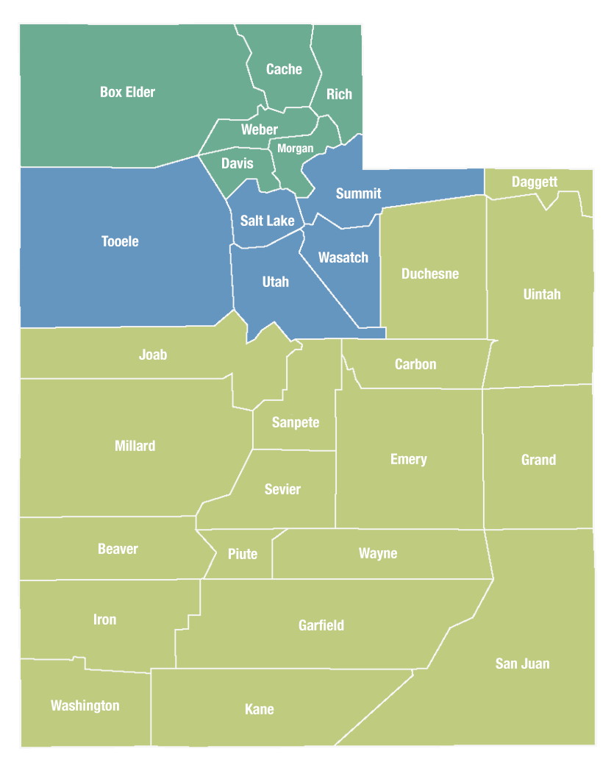
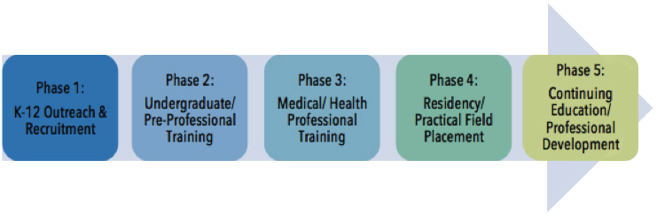
Utah Area Health Education Centers (AHEC)
Education for current and future health professionals for practice in medically underserved rural and urban areas.
Notes:
Mike

Slide 4


Utah Medical Education Council
  Health care workforce analyses: training capacity and graduate medical education (GME) financing policies.
    Since 1997
    “Advise the State Board of Regents and the Legislature on the status and needs of health care professionals in training”
    “Assess and meet changing market and education needs”
    2014 - Designated Utah’s Nursing Workforce Information Center
https://umec.utah.gov/
Notes:
Clark

Slide 5



Utah Population: Very Rural, Very Urban
Third fastest growing state
8th most urbanized state: 75% of the population in four urban counties (Davis, Weber, Salt Lake, Utah)
96% of the land is rural or frontier
Notes:
Clark
Census bureau: Idaho and Nevada are currently tied for fastest

Slide 6



Utah’s Changing Health Care Needs
Utah’s health care spending growth: one of fastest in country
Percent 65 and older: double in next 50 years
Large income gaps between populations, counties
Population health declining: #5 in 2018, down from #1
Increasing mental health needs, substance use disorders, disparities in access and social determinants of health
Source: https://gardner.utah.edu/wp-content/uploads/HealthCareNeedsReportJan2019.pdf
Notes:
Clark

Slide 7
U.S. Average Ratio: 91.1 Primary Care Physicians-Per- 100,000
Source: UMEC Workforce Supply Surveys
Utah is ranked 49th in the nation for primary care physician-per-100,000 population ratio (AAMC)
Notes:
Clark
The “Gold Standard” reference point has been historic ratios of provider to population.

Slide 8
Can’t we just look at Supply vs. Demand?
(Nope!)
“Expressed demand will only provide a sound basis for workforce planning where supply and demand meet (or at least approximate) the conditions of the perfect market. But this applies to neither healthcare nor the health workforce because of constraints on supply (e.g., through registration of professions, restrictions on scope of practice and models of care, and limits on education and training places) and demand distorted by pervasive knowledge failures and third-party payment.”
Source: ﻿An evidence-based health workforce model for primary and community care. Segal and Leach Implementation Science 2011, 6:93 http://www.implementationscience.com/content/6/1/93
Notes:
Mike
Cant use just demand- demand-based approaches will perpetuate any existing inefficiencies and inequalities in access to care and lack capacity to plan – let alone respond to – changes in the levels and distribution of health and risks to health within the population.

Slide 9
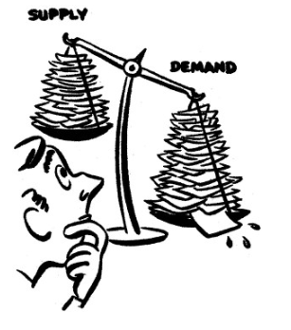
Can’t we just look at Supply vs. Demand?
(Nope!)
Health workforce is not a perfect market – it has constraints:
On supply:
  Registration
  Scope of practice
  Models of care
  Limits on education and training places
On demand:
  Pervasive knowledge failures
  Third-party payment
Source: ﻿An evidence-based health workforce model for primary and community care. Segal and Leach Implementation Science 2011, 6:93 http://www.implementationscience.com/content/6/1/93

Slide 10

Can’t we just look at Supply vs. Demand?
(Nope!)
Health care is changing!
Rear-View Mirror: Historic provider-to-population ratios
Front Windshield: Impacts of changing population health needs and healthcare transformation

Slide 11
Looking out the Front Windshield:
Foundation for a new Primary Care Workforce Model
Control cost of care: 18% of GDP and rising
Primary care: key to reduce cost and improve quality
Team based care and value payment old single-discipline models of workforce need are obsolete
Resource allocation should be driven by:
  Needs of the population: Chronic, Acute,
  Preventive care
  Evolving models of care delivery and professional roles: population management, team roles, documentation
Notes:
Mike

Slide 12

So…
We Need a More Comprehensive Approach!

Slide 13

Utah Workforce Project:
Assumptions for a Comprehensive Approach
Need can be described for a population:
  Chronic, Acute, Preventive
Evidence based guidelines
  drive service needs
Time per service is constant
  regardless of clinician providing the service
Delivering care at the top of the license is ideal
  highest quality, lowest cost
Notes:
Mike

Slide 14
Conceptual Model

Slide 15




Stakeholders Need Solid Data
Educational Leaders
future proof programs so graduates will meet health needs of communities
Clinical Administrators
understand health care needs of a community
forecast future needs
properly staff their teams
Legislators
obtain data: transparent, unbiased
invest in education and policies to maximize health and control cost
Researchers
support key decision makers with a trusted, unbiased source of data
Notes:
Mike

Slide 16


From Elephant to Beehive
Current State
Information (supply and need) is scattered, has large gaps
Few people can access comprehensive data
Different answers to the same question, depending on methodology/sources
Everyone uses data in their own way to support their view of the right solution
Goal State
Best available data sources are gathered for each type of information
Gaps are identified and filled over time
All end-users can access consistent data and transparent trusted results
The data inform a common story that ultimately benefits the Utah population
This Photo by Unknown Author is licensed under CC BY-NC-ND
Notes:
Mike

Slide 17
Needs-Based Analytical Framework*
Provider Supply:
(provider/services)
× (population size)
Service Need:
(services/need)
× (needs/population)
N =
X
Demography: the size of the population being served (population size).
Productivity: the quantity of Full Time Equivalent (FTE) providers required to deliver a given level and mix of services
(provider/services).
Epidemiology: the distribution of health and illness as well as risk factors for future illness in the population
(needs/population).
Level of service: the amount and type of health care services planned to be provided for different levels of health, illness or risk of illness (services/need).
*Birch, S et al. ﻿Health Human Resources Planning and the Production of Health: Development of an Extended Analytical Framework for Needs-Based Health Human Resources Planning. J Public Health Manag Pract. 2009 Nov;15(6 Suppl):S56-61. doi: 10.1097/PHH.0b013e3181b1ec0e.
Notes:
Clark

Slide 18
IBM Data Flow Diagram
Notes:
Clark
AHEC/UMEC initial work to create a basic approach to solving the problem
IBM did the heavy lifting to create a computational model in Python and a prototype of a user interface
We now need to complete the interface in order for non-technical users to interact with the tool and use it for decision making.

Slide 19
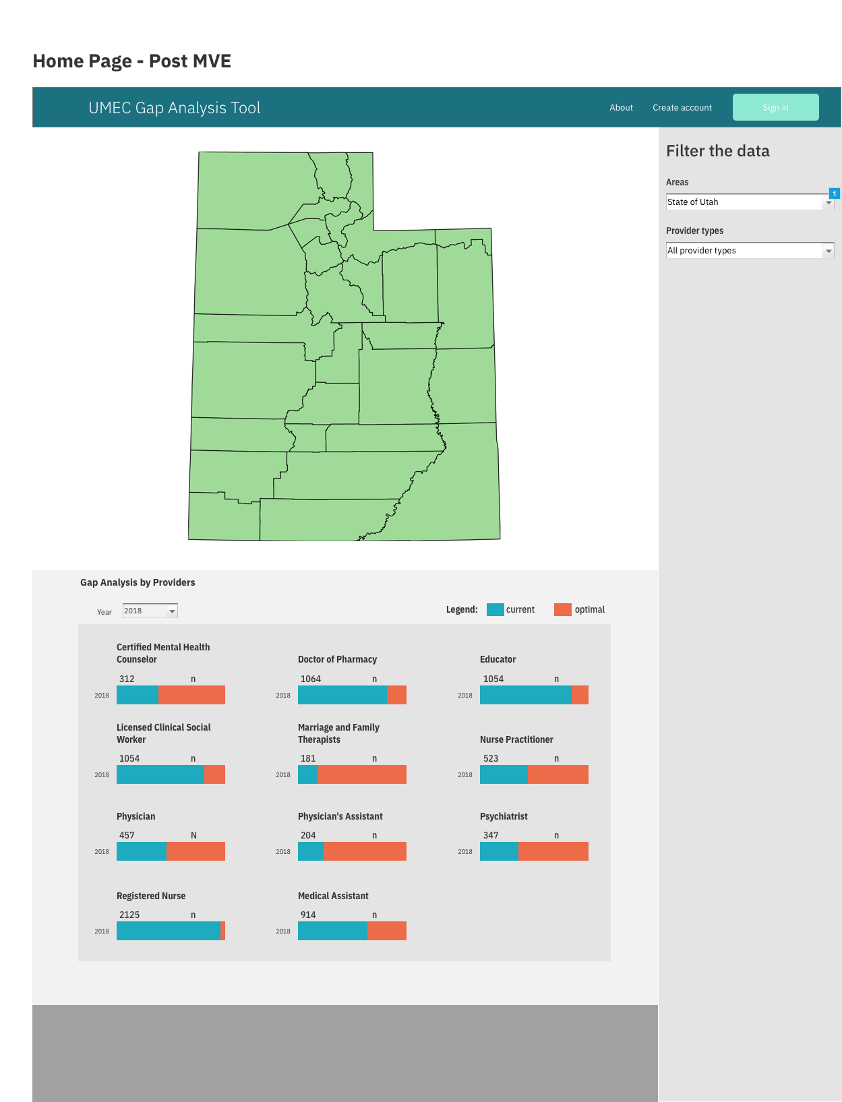
User Interface will filter data geographically.
Map will display:
Optimal Provider Supply/ Need FTEs by profession.
Population health data by age and gender
Notes:
Clark

Slide 20
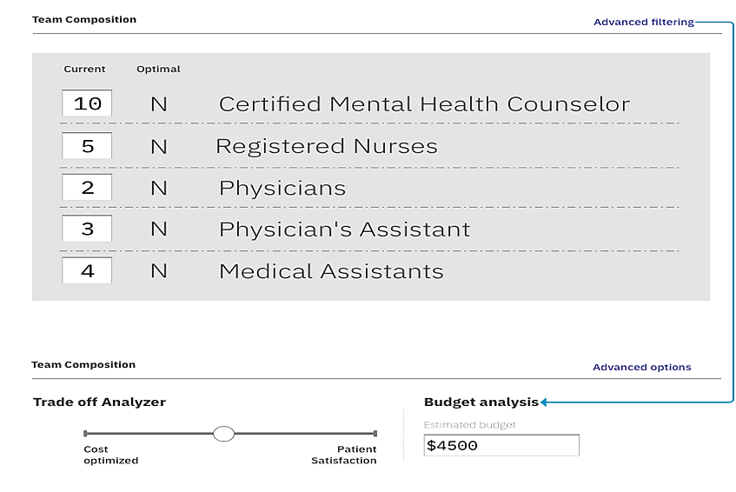
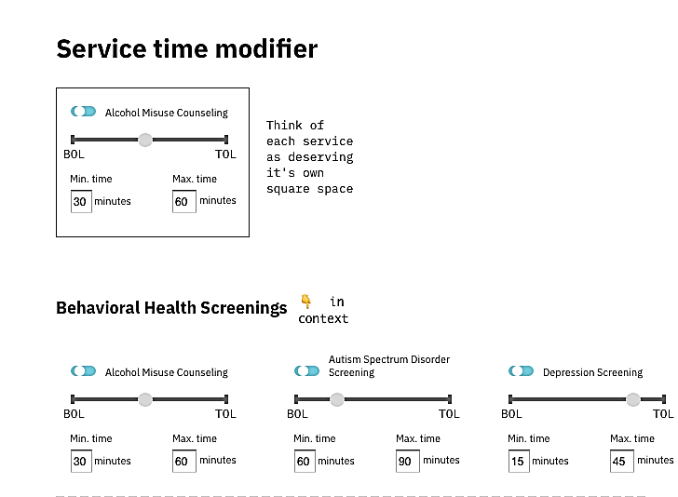
User Interface will show current vs optimal workforce counts
Will allow for users to change current supply numbers and re-run the model analysis
For each service in the model, users can modify professional suitability for service delivery score and time values.
Notes:
Clark

Slide 21
Model Outputs
Ideal provider staffing
  Given population need, what would be an optimal provider team composition (i.e., types and number of providers)
Ideal provider staffing constrained by current providers’ composition
  Given population need and current providers’ composition, what would be an optimal provider team composition
Ideal service/task allocation
  Given provider’s current composition, what would be an optimal task/service allocation
Notes:
Ideal provider staffing
Given population need, what would be an optimal provider team composition (i.e., types and number of providers)
Use case: We have 100k population with 2k patients with diabetes and 1k patients with depression. How many (and what types of) providers do we need to have to provide best primary care?
Ideal provider staffing constrained by current providers’ composition
Given population need and current providers’ composition, what would be an optimal provider team composition
Use case: We have 100k population with 2k patients with diabetes and 1k patients with depression. We already have 2 physicians. How many (and what type) more providers do we need to have?
Ideal service/task allocation
Given provider’s current composition, what would be an optimal task/service allocation
Use case: We have 100k population with 2k patients with diabetes and 1k patients with depression. We have 2 physicians, 1 RN, 2 MA, which is too low to support current population need. How can we allocate services across providers to minimize over-allocation to certain provider type?
Options 1 and 2: (PuLP) Linear Programming is used in Google maps, UPS driver route planning etc
User can set wage or suitability weight and wage max options to constrain the model
Option 3: (CVXOPT) Quadratic Programming Equations are used in image and signal processing, to optimize financial portfolios (capitol asset pricing), to perform the least-squares method of regression, to control scheduling in chemical plants etc…
Model is constrained by available providers

Slide 22
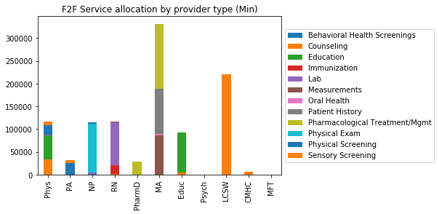
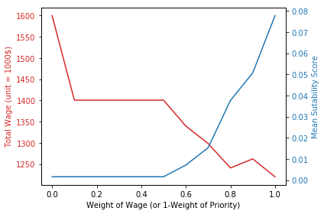
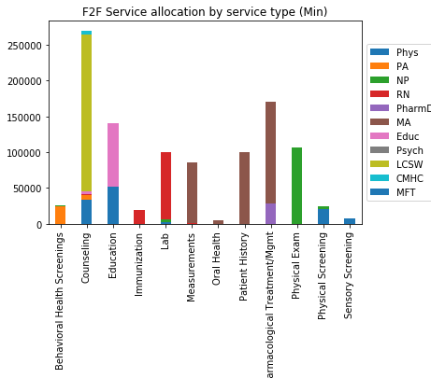
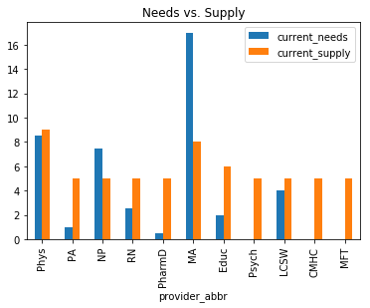
[ideal-staffing] ex: State of Utah
Notes:
Clark

Slide 23
What’s Next? A Five Year Timeline…
Completion of user interface
AHRQ Grant
  Aim 1: Use population health data and evidence-based care guidelines to calculate population based primary healthcare needs.
  Aim 2: Develop a dynamic model for delivery of services by interprofessional team members in primary care.
  Aim 3: Refine user interface and document utility of model output for primary care workforce planning
Potential for scalability of modeling to any geographic area or specific care population with suitable data sources.
Notes:
Clark

Slide 24
Workforce Model Implications
Provide decision makers evidence to support their decisions addressing the primary care workforce shortage, including decisions on:
  Staffing for specific populations (ex: rural vs. urban)
  Funding training pipelines
  Modifying payment model
  Expanding healthcare insurance
Notes:
Clark
This approach encourages the direct consideration of these factors by policy makers in planning for HHR and, more broadly, health systems something which has not been common to date. Secondly, it provides planners with flexibility in the policy scenarios they can consider. Specified levels of service can be included to simulate the impacts of potential policy changes (e.g. removing user fees or increasing recommended screening frequency), or to accommodate service target-based approaches.

Slide 25
Thank you!

